Slide 1
Local Collaboration - Southwark Community Response Fund Sarah Thurman United St Saviour’s Charity

Slide 2
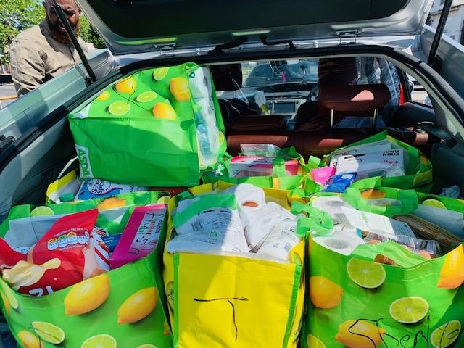
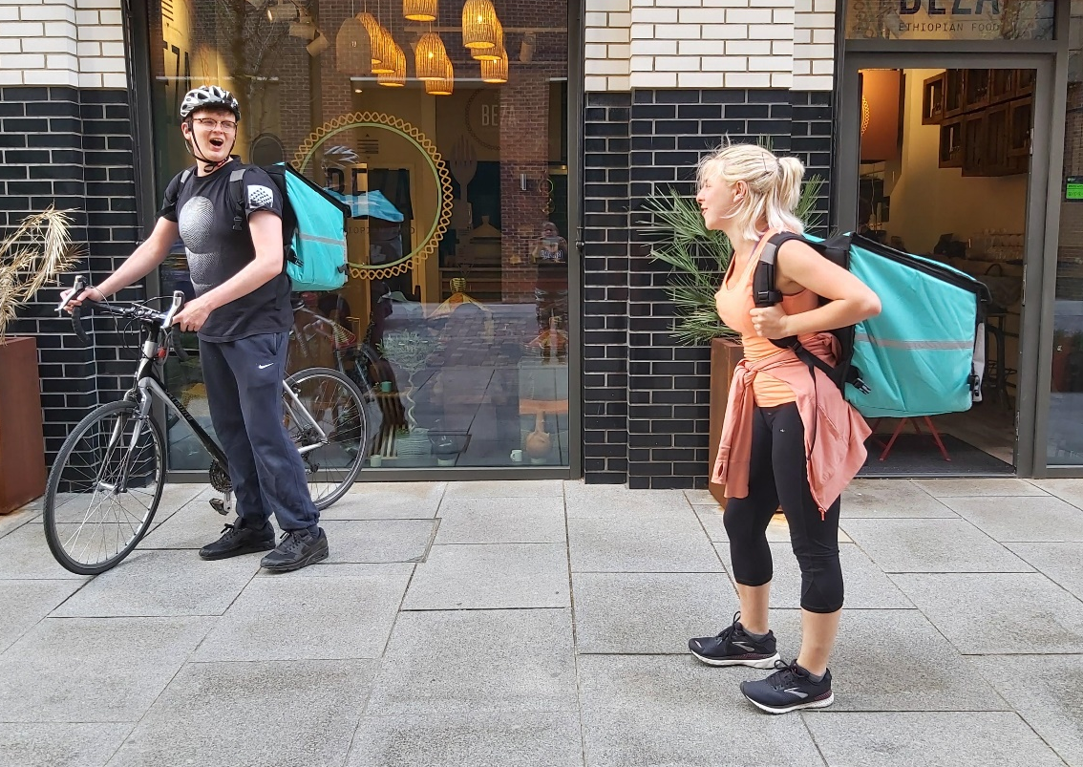
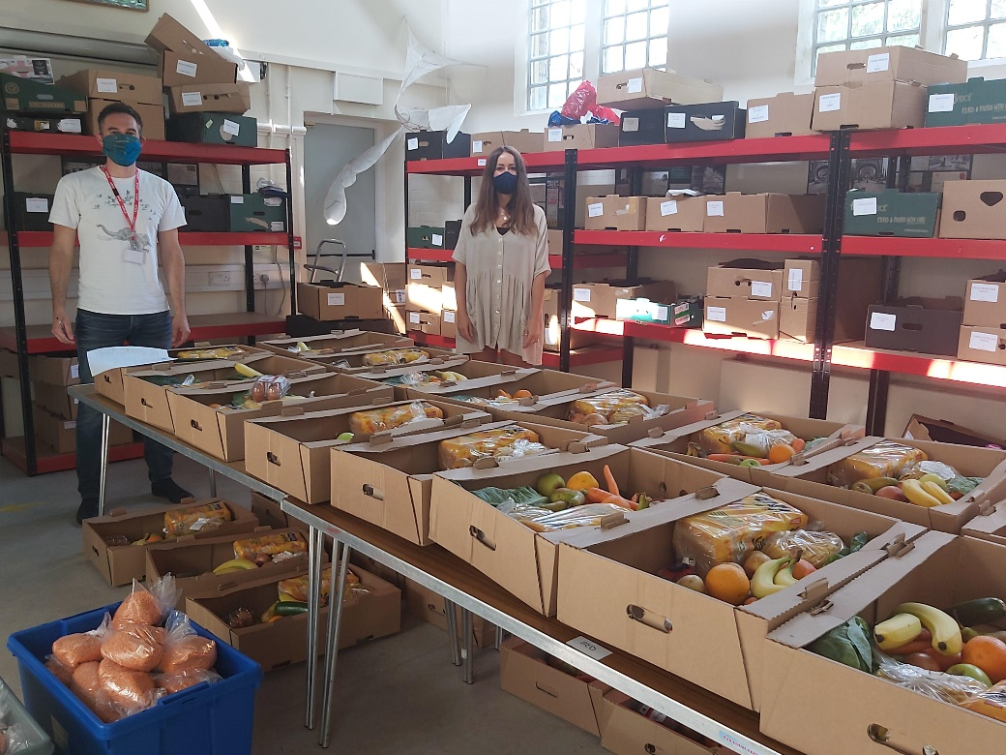
A collaboration within a collaboration! A Southwark-focused fund Lessons & Relationships

Slide 3
Context
Some local collaboration already
Southwark Funders’ Forum – Nov 2019
(Lucky?) meeting 13th March
LCRF kick-off following week
Local call-out for partners
Southwark-specific fund established

Slide 4
A Place-Based Partnership

Slide 5
How It Worked
LCRF ‘aligned’ – shared portal
Managed by UStSC
Pooled funds
Grants to UStSC
Agreed aim – upfront
Agreed principles - upfront
Delegated authority from all trustees
Delegated authority – from some trusts
Aim
‘To support the community of Southwark to overcome the challenges presented by the lockdown, particularly in mitigating the impact on the more vulnerable, socially and economically disadvantaged’
Principles
Speed
Trust
Communication
Minimise admin. burdens
A relational approach

Slide 6
Assessments & Approvals
Speed - of the essence!
Working Group (of 3): assessments & decisions
Advisory Group: information
Fast approvals & payment processing
Ongoing communication
Our Wave 3 – Equalities focus & different process applied
Working Group
The Heavy Lifting!
Daily portal review
Carried out assessments/extra due diligence
Agreed awards
Weekly/twice weekly zooms

Slide 7
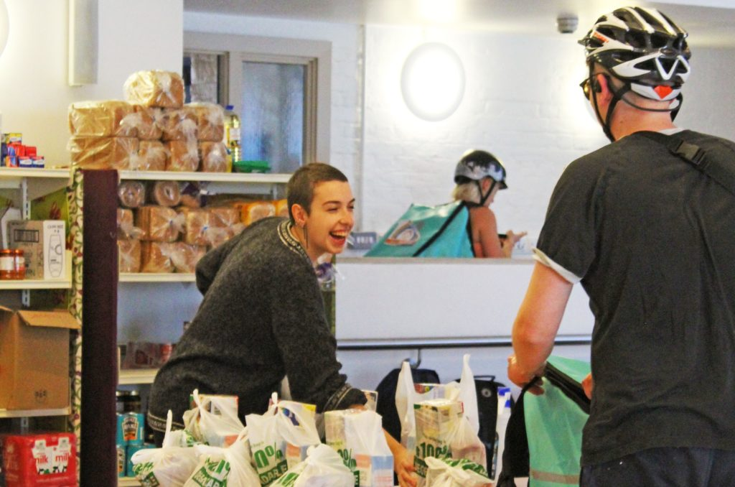
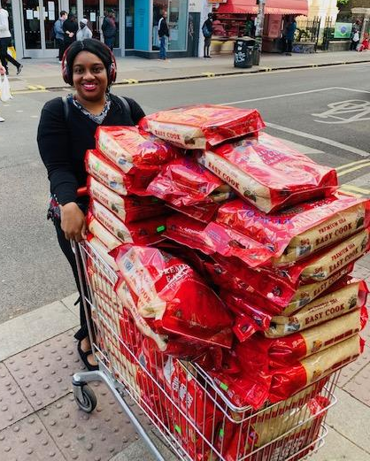
What We Achieved
Pooled & awarded £590k
Grants made 64
SCRF helped ensure:
39,000 residents received support
7,700 families got weekly food/essentials
30,000 cooked meals
6 food hubs funded
1,600 children/YP engaged and supported
IT/Phone upgrades for 5 critical charities
(6500 users)

Slide 8
What Else?
65% of Wave 3 was allocated to small, Black-led groups
Prioritisation in selection
Promotion, BAME network
Proactive engagement and support
Paid ‘Critical Friends’ to work with us

Slide 9
Reflections
Partnership is resource intensive – hidden hard work!
Effective collaboration requires flexibility - funding restrictions challenging
Demonstrated the viability & impact of collaborating around a shared concern.
Benefits beyond funding - profound & fruitful sharing of ideas

Slide 10
Ingredients of Success
Existing relationships and connections provided the basis for the collaboration.
Embedded: place-based finger on the pulse – knowledgeable, connected & literally on the ground. This brought others to the table.
Early delegated authority agreements essential. & clarity on processes.
Egos left behind!

Slide 11
Where Next
Further collaboration planned or ongoing
Southwark @ Christmas Campaign
Southwark Funder Forum
Specific issue collab – sharing/aligning/pooling
Inequalities & poverty
Reviving the ‘Giving’ scheme for Southwark

